Slide 1
Datathon 2021- Final Presentation
Bezirksamt Friedrichshain Kreuzberg
Notes:
Hi,
who we are - Jannes and Eva
Jannes is a researcher in Mathematics at the Freie Universität berlin
I am working as a business intelligence analyst at betterplace
We have both been with DSSG for a couple of years now and work in the orga team.

Slide 2
Points of Interest (POI)

Slide 3
Problem Description
There are various venues where people stop by to do something. They are called Points of Interest (POI). Some example of types of POI:
Churches, schools, town halls, distinctive buildings
Post offices, shops, postboxes, telephone boxes
Pubs (pub names are useful when navigating by map)
Car parks and lay-bys (and whether free or not)
Speed cameras
Tourist attractions
We have 98 POI types in consideration. Different POIs have varying parking needs

Slide 4

Solution
The first obvious approach is to analyse the parking needs for all the Points of Interest.
This means:
Considering a radius around a POI (e.g. 40m)
Numbers of Cars tagged within the radius
Number of Parking spots available within the radius
Ratio of cars present (tagged) and parking spot, named Parking Consumption
GitHub Repo: https://github.com/HasanShaukat/dssg_2021_point_of_interest.git

Slide 5
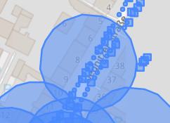
The Data

Slide 6
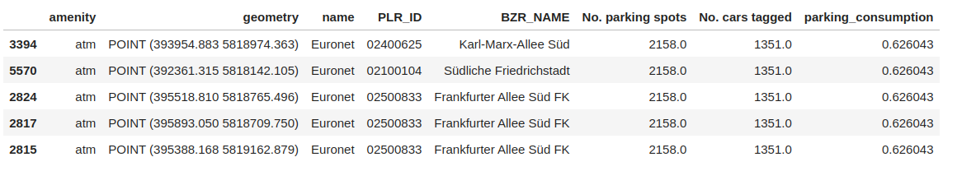
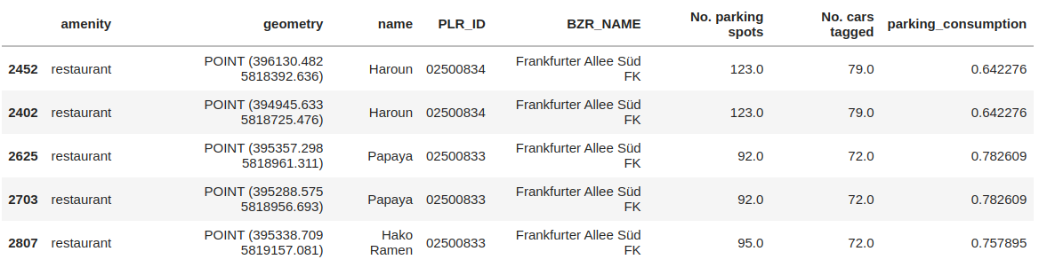
Resulting Dataset

Slide 7
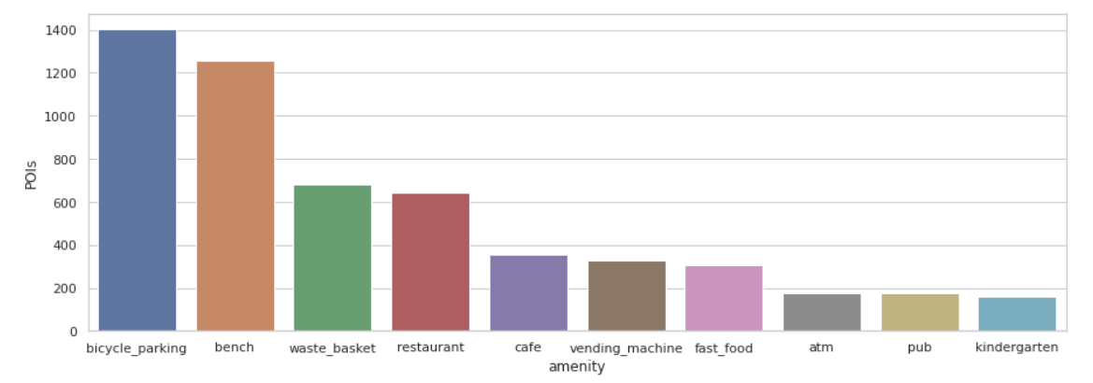
Insights
Number of POIs per amenity

Slide 8
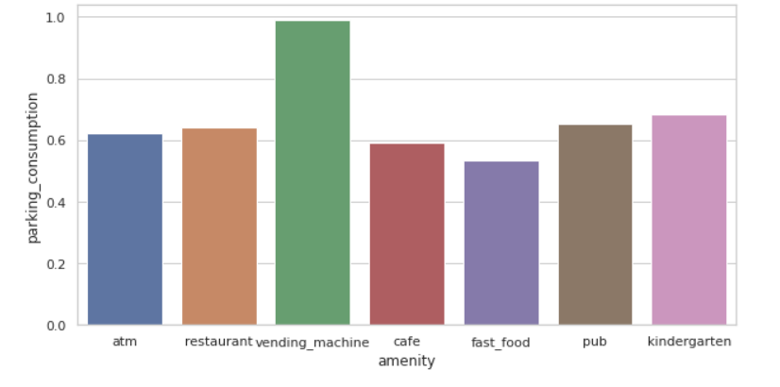
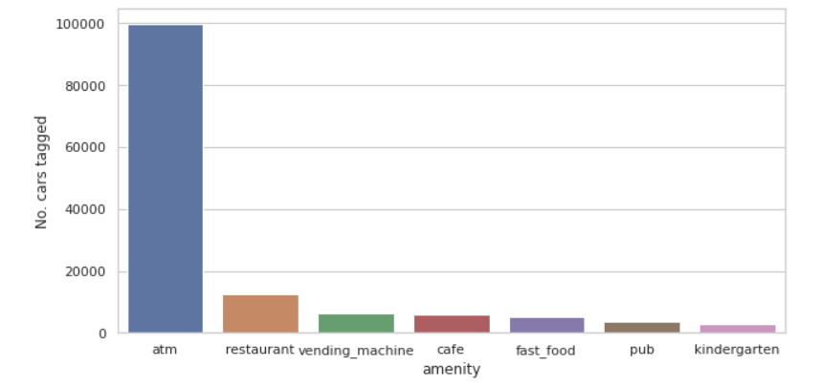
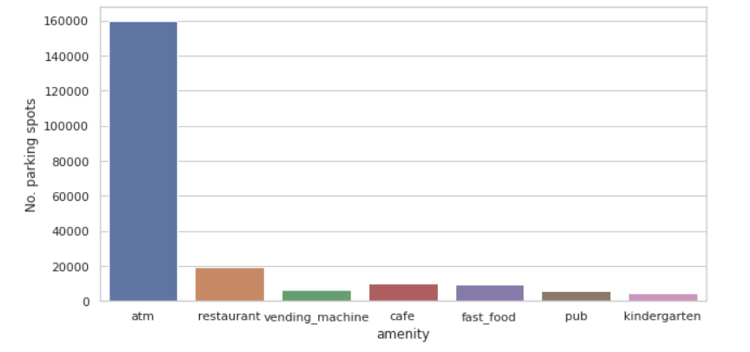
Insights
Parking Consumption Ratio
Tagged Cars
Parking Spots

Slide 9
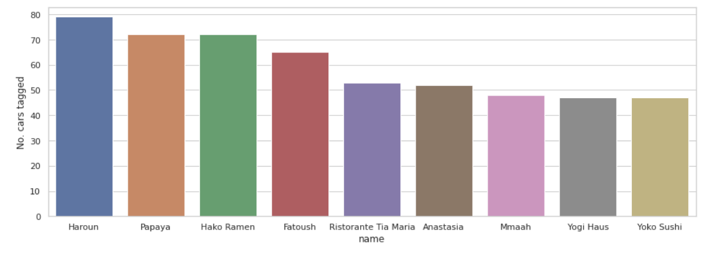
Insights
Individual POIs of an amenity (e.g. Restaurants)

Slide 10
Key Benefits
Impact:
Manage parking needs of existing POIs
Estimate parking expectations of new POIs
How sustainable is the impact?
Depends largely on traffic trends, e.g. might change in a lockdown

Slide 11
Resources Needed
Data:
estimated_parking_spots_kfz.geojson
counted_cars_from_cartagger_project.geojson
Points of Interest from OpenStreetMaps
Technology:
Jupyter Notebook in Python
Can create a dashboard afterwards in any platform
Expertise:
Geopandas
OpenStreetMap

Slide 12
Limitations, Risks & Lessons Learned
Data: availability, reliability, privacy or other ethical issues, technical limitations?
Accuracy of Parking Spot data
Cars were tagged in 2006, while Parking spots were obtained in 2020/2021
Tagged cars are overall less in quantity than estimated parking spots
Could be because of limited efforts to tag cars
Or in 2006 cars might be less
Overlap of adjacent POIs causing one POI to affect another one’s surrounding
POIs pointing to a building’s center, could be far from the relevant street and have nothing in a 40m radius
Duplicate values of POIs (with different coordinates)

Slide 13
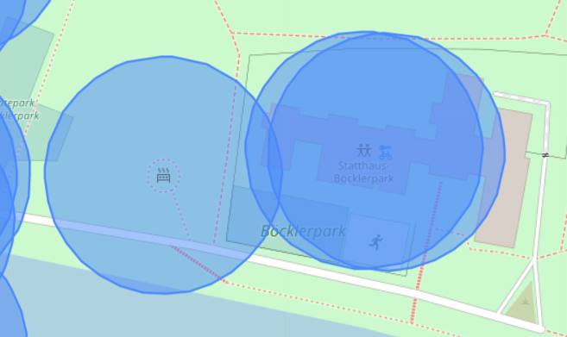
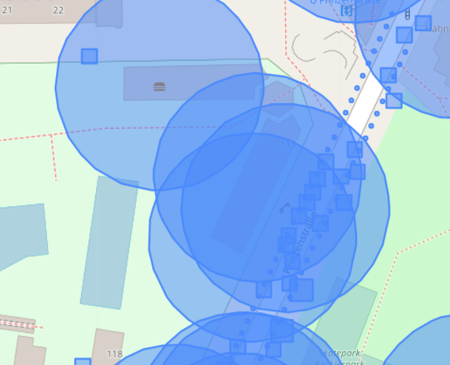
Complications
POIs away from the street
Overlapping POI vicinities

Slide 14
Limitations, Risks & Lessons Learned
Technology:
Completely open source
Just need memory and CPU power to present data points
Expertise:
Projecting POI points onto streets
Lessons learned:
Data consistent in time and in metrics would prove helpful

Slide 15
Thank You
Hasan Shaukat
Michel F.

